Slide 1
Performance Metrics

Slide 4
2016-17
2017-18
CHANGE

Slide 5
Total Score: New College
75
70
59
50

Slide 6
Total Score: New College and other SUS schools
UF
UF
USF
FAU, UCF
UF
UCF
USF
FGCU
FAU
FIU
75
USF
FIU, FSU, UWF
UNF
70
FIU, UCF
FSU
FSU
FGCU
FAMU
FGCU
59
FAMU, UNF
UWF
UNF
FAMU
50
FAU
UWF

Slide 7
Total Score ≤ 50: lose base institutional funding
UF
UF
USF
FAU, UCF
UF
UCF
USF
FGCU
FAU
FIU
75
USF
FIU, FSU, UWF
UNF
70
FIU, UCF
FSU
FSU
FGCU
FAMU
FGCU
59
FAMU, UNF
UWF
UNF
FAMU
50
FAU
UWF

Slide 8
Total Score in bottom 3: no state investment
UF
UF
USF
FAU, UCF
UF
UCF
USF
FGCU
FAU
FIU
75
USF
FIU, FSU, UWF
UNF
70
FIU, UCF
FSU
FSU
FGCU
FAMU
FGCU
59
FAMU, UNF
UWF
UNF
FAMU
50
FAU
UWF

Slide 9
Total Score in top 3: base + state + bonus
UF
UF
USF
FAU, UCF
UF
UCF
USF
FGCU
FAU
FIU
75
USF
FIU, FSU, UWF
UNF
70
FIU, UCF
FSU
FSU
FGCU
FAMU
FGCU
59
FAMU, UNF
UWF
UNF
FAMU
50
FAU
UWF

Slide 10
Metrics

Slide 11
Metric #1
Percent of Bachelor’s Graduates Enrolled or Employed ($25,000+) in the U.S. One Year After Graduation

Slide 12
Metric #1
Percent of Bachelor’s Graduates Enrolled or Employed ($25,000+) in the U.S. One Year After Graduation
May
2015
Jan. 2016
April 1
June 30
July 31
earn $6,250+*
enroll in a course
receive an overseas scholarship

Slide 13
1: % enrolled, earned $25k+, overseas in 14 months

Slide 14
1: % enrolled, earned $25k+, overseas in 14 months

Slide 15
1: % enrolled, earned $25k+, overseas in 14 months

Slide 16
1: % enrolled, earned $25k+, overseas in 14 months

Slide 17
1: % enrolled, earned $25k+, overseas in 14 months

Slide 18
1: % enrolled, earned $25k+, overseas in 14 months

Slide 19
Metric #2
Median Wages of Bachelor’s Graduates Employed Full-Time in Florida One Year After Graduation

Slide 20
Metric #2
Median Wages of Bachelor’s Graduates Employed Full-Time in Florida One Year After Graduation
Graduating Class of 2015
wages earned from April – June of 2016

Slide 21
Metric #2
Median Wages of Bachelor’s Graduates Employed Full-Time in Florida One Year After Graduation
Graduating Class of 2015
Part-time
earned $4,125 or more
wages earned from April – June of 2016

Slide 22
Metric #2
Median Wages of Bachelor’s Graduates Employed Full-Time in Florida One Year After Graduation
Graduating Class of 2015
4 x median
Part-time
earned $4,125 or more
wages earned from April – June of 2016

Slide 23
2: median wages 14 months after graduating

Slide 24
2: median wages 14 months after graduating

Slide 25
2: median wages 14 months after graduating

Slide 26
Metric #3
Cost to the Student:
Net Tuition and Fees per 120 Credit Hours

Slide 27
Metric #3
Cost to the Student:
Net Tuition and Fees per 120 Credit Hours
tuition per credit
+ fees per credit
+ books per credit
credit hours attempted by graduates
sticker price
x
financial aid
scholarships per credit
+ grants per credit
+ waivers per credit
124
credit
hours
x
net tuition & fees

Slide 28
3: net cost to student

Slide 29
3: net cost to student

Slide 30
3: net cost to student

Slide 31
3: net cost to student

Slide 32
Metric #4
Six Year FTIC Graduation Rate
FTIC = first time in college
FTIC = students entering with < 12 credits after high school

Slide 33
4: 6-year graduation rate

Slide 34
4: 6-year graduation rate

Slide 35
4: 6-year graduation rate

Slide 36
4: 6-year graduation rate

Slide 37
4: 6-year graduation rate

Slide 38
Lightning Round

Slide 39
5: First-to-second year retention rate

Slide 40
6: STEM, international, environmental studies degrees

Slide 41
7: Percent of students with Pell Grants

Slide 42
7: Percent of students with Pell Grants

Slide 43
8a: Graduate Degrees Awarded in Areas of Strategic Emphasis
8b: % of freshmen in top 10% of high school class

Slide 44
8b: % of freshmen in top 10% of high school class

Slide 45
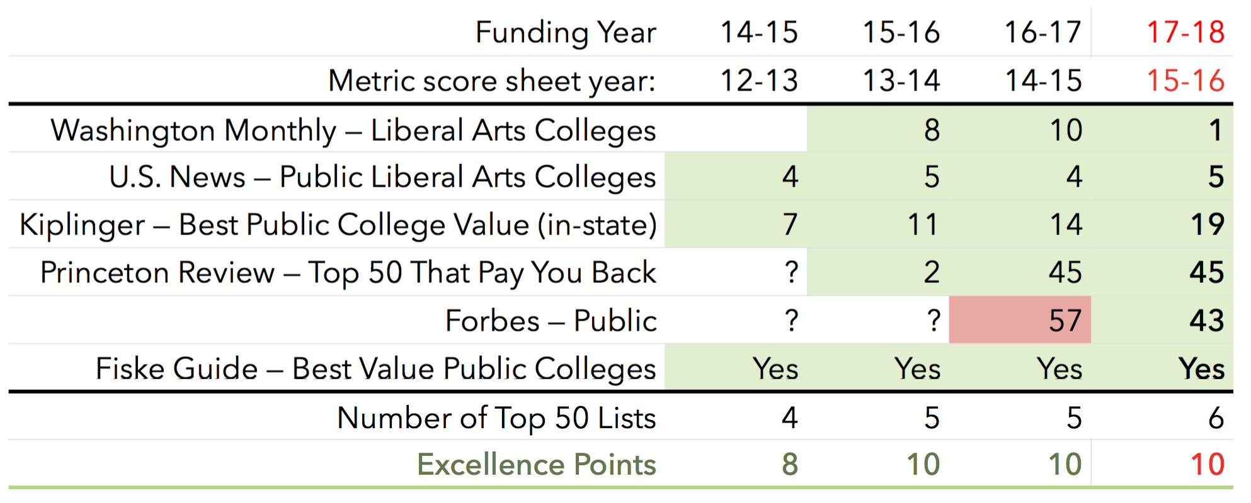
9: BOG Choice — # of (top 50) national rankings

Slide 46
10: BOT Choice:
% of seniors participating in research course

Slide 47
10: Percent of seniors participating in research course

Slide 48
2014-15
2015-16
2016-17
2017-18

Slide 49
2014-15
2015-16
1-2: Post-graduation employment or enrollment
4-5: Graduation and retention rates
2016-17
2017-18

Slide 50
10: Percent of seniors participating in research course

Slide 51
10: By September 1, 2017, each BOT should:
• Choose 3 metrics from SUS Strategic Plan indicators
• Propose excellence benchmarks (1-10)
• Propose improvement benchmarks (1-10)

Slide 52
10: By September 1, 2017, each BOT should:
• Choose 3 metrics from SUS Strategic Plan indicators
• Propose excellence benchmarks (1-10)
• Propose improvement benchmarks (1-10)
— prioritized list
— earn no more than 7 points in the first year

Slide 53
10: Federally-funded R&D Expenditures

Slide 54
10: Percent of alumni donors

Slide 55
10: Percent of alumni donors

Slide 56
10: Percent of alumni donors

Slide 57
10: Percent of seniors participating in research course
10: Percent of students participating in research course
10: Percent of seniors collaborating on research
10: Percent of students publishing/presenting research

Slide 58
10: Percent of seniors completing an internship
Percent of students self-reporting internships: 45-60%
% internship activities appearing on transcript: 25-40%
Percent with transcripted internships

Slide 59
10: Percent of seniors completing 3+ HIPs
High Impact Practices
• Learning communities
• Service- or community-based learning
• Research with faculty
• Internship, practicum, co-op
• Study abroad
• Culminating senior experience

Slide 60
Metric 10: BOT Choice
• Meaningful, important
• Paper trail
• Score of 7 with improvement

Slide 61
SUS Strategic Plan Indicators — some possible options:
1. Average Time to Degree
2. Four-Year Graduation Rates
3. Percent of Bachelor’s Degrees without Excess Hours
4. Number of Adult Undergraduates Enrolled
5. Bachelor’s Degrees (or Graduate Degrees) Awarded Annually
7. Bachelor’s Degrees Awarded to African-American & Hispanic Students
8. % of Bachelor’s degrees awarded in Global Competitiveness Area
9. Faculty Membership in National Academies
10. Faculty Awards
11. Carnegie Foundation’s Community Engagement Classification
12. Total R&D Expenditures
13. Percent of R&D Expenditures funded from External Sources
14. % of Seniors Engaged in Research or Assisting in Faculty Research
16. % of students participating in an internship for academic credit
17. Alumni giving percentage

