Slide 1
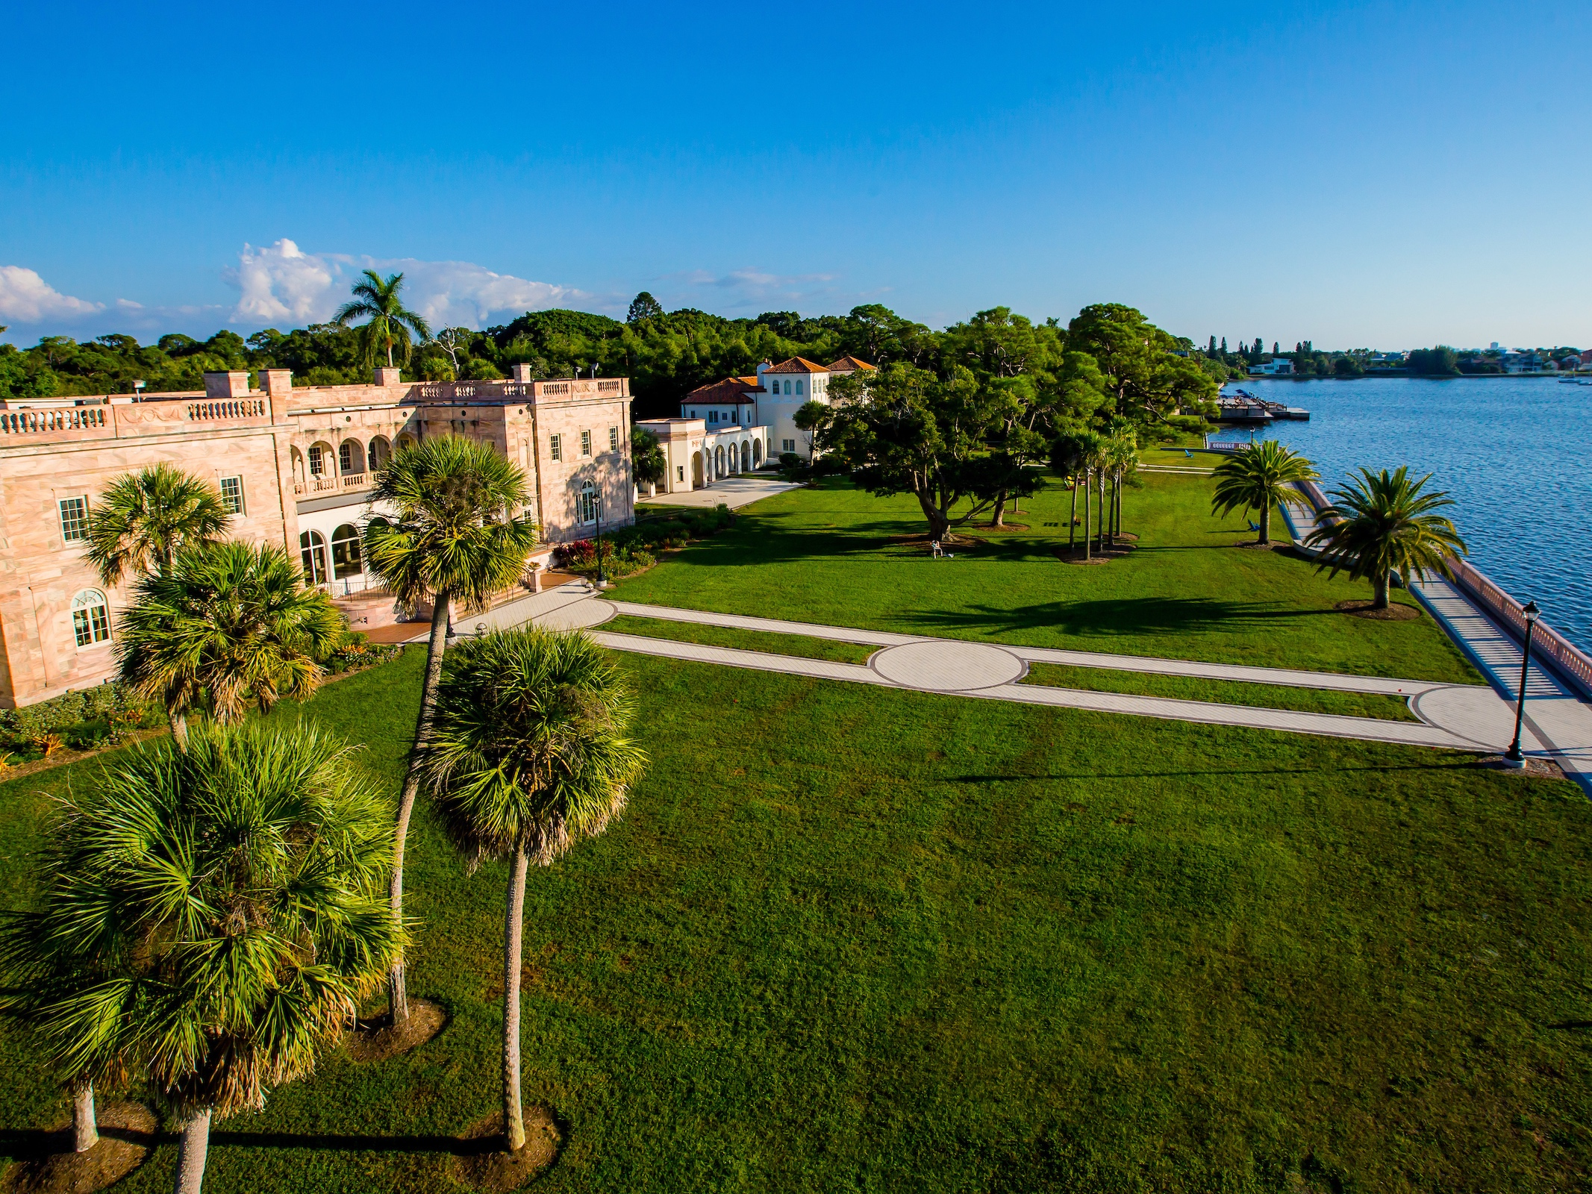
Performance Metrics: 2018 Update

Slide 2
Performance Metrics

Slide 3
Performance Funding
 | Traditional | Performance
$$$ for…
Incentivizes…
Does not incentivize…

Slide 4
Performance Funding
 | Traditional | Performance
$$$ for… | Enrollment
Incentivizes… | Access
Does not incentivize… | Completion

Slide 5
Performance Funding
 | Traditional | Performance
$$$ for… | Enrollment | Metrics
Incentivizes… | Access | Performance
Does not incentivize… | Completion | Access?

Slide 6
Florida PBF
$1 of every $6 appropriated
$600M
$400M
$200M
state funding
institutional base funding

Slide 7
How have we fared?
 | 2014-15 | 2015-16 | 2016-17 | 2017-18 | 2018-19
Base Funds | $1.1 M | $2.5 M | $2.7 M | $2.8 M | $3.9 M
State Funds | $0 M | $0 M | $0 M | $2.5 M | ???
Total | $1.1 M | $2.5 M | $2.7 M | $5.3 M | ???

Slide 8
How have we fared?
 | 2014-15 | 2015-16 | 2016-17 | 2017-18 | 2018-19
State Funds | $0 M | $0 M | $0 M | $2.5 M | ???
other universities:
$11M - $216M
in state funds

Slide 9
How have we fared?
State Funds | Possible outcomes for 2018-19: |  |  | $0 M — $12.3 M

Slide 10
How does this work?

Slide 11
 |  | Performance |  |  | Points
 |  | for 2016-17 | for 2017-18 | change | 2016-17 | 2017-18 | change
1 | % employed ($25,000+) or enrolled one year after graduation | 43.8% | 41.8% | -1.9%pts | 0 | 0 | --
2 | Median wages of bachelor’s graduates employed full-time one year after graduation | $25,000 | $26,500 | +6.0% | 3 | 10* | +7
3 | Cost to the student: net tuition & fees per 120 credit hours | $8,190 | $5,920 | -27.7% | 0 | 10 | +10
4 | Six-year graduation rate for First-Time-in-College (FTIC) students | 70.5% | 63.4% | -7.1%pts | 10 | 4 | -6
5 | Academic progress rate | 81.3% | 84.3% | +3.0%pts | 3 | 6* | +3
6 | Bachelor’s degrees awarded within programs of strategic emphasis | 39.5% | 45.9% | +6.3%pts | 5 | 10 | +5
7 | University access rate | 30.0% | 28.3% | -1.6%pts | 10 | 8 | -2
8 | Freshmen in Top 10% of graduating high school class | 45% | 43% | -2%pts | 8 | 7 | -1
9 | BOG Choice: Percent of baccalaureate degrees awarded without excess hours | 5 | 5 | -- | 10 | 10 | --
10 | BOT Choice: % of undergraduate seniors participating in research course | 100% | 100% | -- | 10 | 10 | --
 |  |  | total score: |  | 59 | 75 | +16

Slide 12
 |  | Performance |  |  | Points
 |  | for 2016-17 | for 2017-18 | change | 2016-17 | 2017-18 | change
1 | % employed ($25,000+) or enrolled one year after graduation | 43.8% | 41.8% | -1.9%pts | 0 | 0 | --
2 | Median wages of bachelor’s graduates employed full-time one year after graduation | $25,000 | $26,500 | +6.0% | 3 | 10* | +7
3 | Cost to the student: net tuition & fees per 120 credit hours | $8,190 | $5,920 | -27.7% | 0 | 10 | +10
4 | Six-year graduation rate for First-Time-in-College (FTIC) students | 70.5% | 63.4% | -7.1%pts | 10 | 4 | -6
5 | Academic progress rate | 81.3% | 84.3% | +3.0%pts | 3 | 6* | +3
6 | Bachelor’s degrees awarded within programs of strategic emphasis | 39.5% | 45.9% | +6.3%pts | 5 | 10 | +5
7 | University access rate | 30.0% | 28.3% | -1.6%pts | 10 | 8 | -2
8 | Freshmen in Top 10% of graduating high school class | 45% | 43% | -2%pts | 8 | 7 | -1
9 | BOG Choice: Percent of baccalaureate degrees awarded without excess hours | 5 | 5 | -- | 10 | 10 | --
10 | BOT Choice: % of undergraduate seniors participating in research course | 100% | 100% | -- | 10 | 10 | --
 |  |  | total score: |  | 59 | 75 | +16

Slide 13
 |  | Performance |  |  | Points
 |  | for 2016-17 | for 2017-18 | change | 2016-17 | 2017-18 | change
1 | % employed ($25,000+) or enrolled one year after graduation | 43.8% | 41.8% | -1.9%pts | 0 | 0 | --
2 | Median wages of bachelor’s graduates employed full-time one year after graduation | $25,000 | $26,500 | +6.0% | 3 | 10* | +7
3 | Cost to the student: net tuition & fees per 120 credit hours | $8,190 | $5,920 | -27.7% | 0 | 10 | +10
4 | Six-year graduation rate for First-Time-in-College (FTIC) students | 70.5% | 63.4% | -7.1%pts | 10 | 4 | -6
5 | Academic progress rate | 81.3% | 84.3% | +3.0%pts | 3 | 6* | +3
6 | Bachelor’s degrees awarded within programs of strategic emphasis | 39.5% | 45.9% | +6.3%pts | 5 | 10 | +5
7 | University access rate | 30.0% | 28.3% | -1.6%pts | 10 | 8 | -2
8 | Freshmen in Top 10% of graduating high school class | 45% | 43% | -2%pts | 8 | 7 | -1
9 | BOG Choice: Percent of baccalaureate degrees awarded without excess hours | 5 | 5 | -- | 10 | 10 | --
10 | BOT Choice: % of undergraduate seniors participating in research course | 100% | 100% | -- | 10 | 10 | --
 |  |  | total score: |  | 59 | 75 | +16

Slide 14
 |  | Performance |  |  | Points
 |  | for 2016-17 | for 2017-18 | change | 2016-17 | 2017-18 | change
1 | % employed ($25,000+) or enrolled one year after graduation | 43.8% | 41.8% | -1.9%pts | 0 | 0 | --
2 | Median wages of bachelor’s graduates employed full-time one year after graduation | $25,000 | $26,500 | +6.0% | 3 | 10* | +7
3 | Cost to the student: net tuition & fees per 120 credit hours | $8,190 | $5,920 | -27.7% | 0 | 10 | +10
4 | Six-year graduation rate for First-Time-in-College (FTIC) students | 70.5% | 63.4% | -7.1%pts | 10 | 4 | -6
5 | Academic progress rate | 81.3% | 84.3% | +3.0%pts | 3 | 6* | +3
6 | Bachelor’s degrees awarded within programs of strategic emphasis | 39.5% | 45.9% | +6.3%pts | 5 | 10 | +5
7 | University access rate | 30.0% | 28.3% | -1.6%pts | 10 | 8 | -2
8 | Freshmen in Top 10% of graduating high school class | 45% | 43% | -2%pts | 8 | 7 | -1
9 | BOG Choice: Percent of baccalaureate degrees awarded without excess hours | 5 | 5 | -- | 10 | 10 | --
10 | BOT Choice: % of undergraduate seniors participating in research course | 100% | 100% | -- | 10 | 10 | --
 |  |  | total score: |  | 59 | 75 | +16

Slide 15
 |  | Performance |  |  | Points
 |  | for 2016-17 | for 2017-18 | change | 2016-17 | 2017-18 | change
1 | % employed ($25,000+) or enrolled one year after graduation | 43.8% | 41.8% | -1.9%pts | 0 | 0 | --
2 | Median wages of bachelor’s graduates employed full-time one year after graduation | $25,000 | $26,500 | +6.0% | 3 | 10* | +7
3 | Cost to the student: net tuition & fees per 120 credit hours | $8,190 | $5,920 | -27.7% | 0 | 10 | +10
4 | Six-year graduation rate for First-Time-in-College (FTIC) students | 70.5% | 63.4% | -7.1%pts | 10 | 4 | -6
5 | Academic progress rate | 81.3% | 84.3% | +3.0%pts | 3 | 6* | +3
6 | Bachelor’s degrees awarded within programs of strategic emphasis | 39.5% | 45.9% | +6.3%pts | 5 | 10 | +5
7 | University access rate | 30.0% | 28.3% | -1.6%pts | 10 | 8 | -2
8 | BOG Choice: Freshmen in Top 10% of graduating high school class | 45% | 43% | -2%pts | 8 | 7 | -1
9 | BOG Choice: Top 50 national rankings | 5 | 5 | -- | 10 | 10 | --
10 | BOT Choice: % of undergraduate seniors participating in research course | 100% | 100% | -- | 10 | 10 | --
 |  |  | total score: |  | 59 | 75 | +16

Slide 16
Total Score

Slide 17
Total Score
UF
UF
UF
USF
FAU, UCF
USF
UF
UWF
FSU
UCF
USF
UCF
FGCU
FAU
FIU
USF
FIU, FSU, UWF
UNF
FAU
FIU, UCF
FSU
FIU
FSU
FGCU
FGCU
FAMU
FAMU
FGCU
FAMU, UNF
UWF
UNF
UNF
FAMU
FAU
UWF

Slide 18
Total Score
UF
UF
UF
USF
FAU, UCF
USF
UF
UWF
FSU
UCF
USF
UCF
FGCU
FAU
FIU
USF
FIU, FSU, UWF
UNF
FAU
FIU, UCF
FSU
FIU
FSU
FGCU
FGCU
FAMU
FAMU
FGCU
FAMU, UNF
UWF
UNF
UNF
lose base
funding
FAMU
FAU
UWF

Slide 19
Total Score
UF
UF
UF
USF
FAU, UCF
USF
UF
UWF
FSU
UCF
USF
UCF
FGCU
FAU
FIU
USF
FIU, FSU, UWF
UNF
FAU
FIU, UCF
FSU
FIU
FSU
FGCU
FGCU
FAMU
FAMU
no state investment
FGCU
FAMU, UNF
UWF
UNF
UNF
FAMU
FAU
UWF

Slide 20
Total Score
UF
bonus
investment
UF
UF
USF
FAU, UCF
USF
UF
UWF
FSU
UCF
USF
UCF
FGCU
FAU
FIU
USF
FIU, FSU, UWF
UNF
FAU
FIU, UCF
FSU
FIU
FSU
FGCU
FGCU
FAMU
FAMU
FGCU
FAMU, UNF
UWF
UNF
UNF
FAMU
FAU
UWF

Slide 21
Total Score

Slide 22
Total Score

Slide 23
Metrics

Slide 24
1. % enrolled or employed ($25k)
Percent of bachelor’s graduates enrolled or employed ($25,000+) in the U.S. one year after graduation

Slide 25
1. % enrolled or employed ($25k)
Percent of bachelor’s graduates with valid SSNs enrolled within 426 days of graduation in any course offered by the 3,724 schools that report to the National Student Clearinghouse,
or employed (but not self-employed, temporarily employed, or employed by a church or association of churches) earning $6,250 from April 1 through June 30 of the year after graduation in one of 43 states in the U.S. (including Washington D.C. and Puerto Rico) that report to the Wage Record Interchange System 2,
or overseas on a scholarship within 14 months of graduation.

Slide 26
1. % enrolled or employed ($25k)
Percent of bachelor’s graduates…
2017
2018
2018
May
Jan
April 1
June 30
July 31
earn $6,250+*
enroll in a course
receive an overseas scholarship

Slide 27
1. % enrolled or employed ($25k)

Slide 28
1. % enrolled or employed ($25k)

Slide 29
1. % enrolled or employed ($25k)

Slide 30
1. % enrolled or employed ($25k)

Slide 31
1. % enrolled or employed ($25k)
all other SUS schools

Slide 32
1. % enrolled or employed ($25k)
Long-term:
• 96% of 2010-16 graduates are employed or enrolled
Short-term:
• 10 employed in non-reporting states (60%)

Slide 33
2. Median salary
all other SUS schools
4 excellence

Slide 34
2. Median salary
$37k
with 10 students in non-reporting states

Slide 35
3. Cost of degree to student
all other SUS schools
10 excellence

Slide 36
3. Cost of degree to student
Per degree
Sticker Price
+$390
(+2 credits)
Financial Aid
–$350

Slide 37
4. Four-year graduation rate
10 excellence

Slide 38
4. Four-year graduation rate

Slide 39
5. Retention rate
1 excellence

Slide 40
6. Undergraduate degrees in STEM or Global
10 excellence

Slide 41
7. Percent of Pell recipients
6 excellence

Slide 42
7. Percent of Pell recipients
6 excellence
9 with previous benchmarks

Slide 43
8. Graduate degrees in STEM
100% of our graduate degrees are in STEM fields
(Master of Science in Data Science)

Slide 44
8. Freshmen in top 10% of high school class
6 improvement

Slide 45
8. Freshmen in top 10% of high school class
4 excellence

Slide 46
8. Freshmen in top 10% of high school class
District Ranks?
Counselor Calls?
Honors HS?

Slide 47
9. Percent of graduates without excess hours
10 excellence

Slide 48
10. Seniors completing thesis
10 excellence

Slide 49
10. Graduates completing 3+ HIPs
High-Impact Practices
Capstone project / thesis
Internship
Study Abroad
Writing-intensive course
Living-learning community
Externally-funded research with faculty
First-year experience
Learning community
Service learning
Collaborative projects

Slide 50
Did we earn state funds?

Slide 51
Scores for 2018-19

Slide 52
Scores for 2018-19
UF
FIU
FSU, USF, UWF
FAU
UCF
FGCU*
FAMU
UNF

Slide 53
Scores for 2018-19
UF
FIU
FSU, USF, UWF
FAU
UCF
FGCU*
FAMU
UNF

Slide 54
Scores for 2018-19
Tie breaker!!!
FGCU*

Slide 55
Scores for 2018-19
$0 in state investment

Slide 56
Scores for 2018-19
How to earn $3.5M…
Without really trying
• Same metrics as other schools (81 pts)
or
• Employment data from 50 states (79 pts)
or
• No change to Pell benchmark (78 pts)
or
• Use most recent data (77 pts)
or
• Allow district ranks / honors HS (76+ pts)
or
• Use consistent rounding rules (no tie)

Slide 57
Scores for 2018-19
How to earn $3.5M…
With effort
• +3 students retained
or
• +4 Pell recipients
or
• +3 freshmen in top 10%
or
• +$1,500 in median salary
or
• -3 freshmen admitted who did not return

Slide 58
How can we ensure this
never happens again?

Slide 59
What’s our plan?

Slide 60
Strategic
^
What’s our plan?

