Slide 1
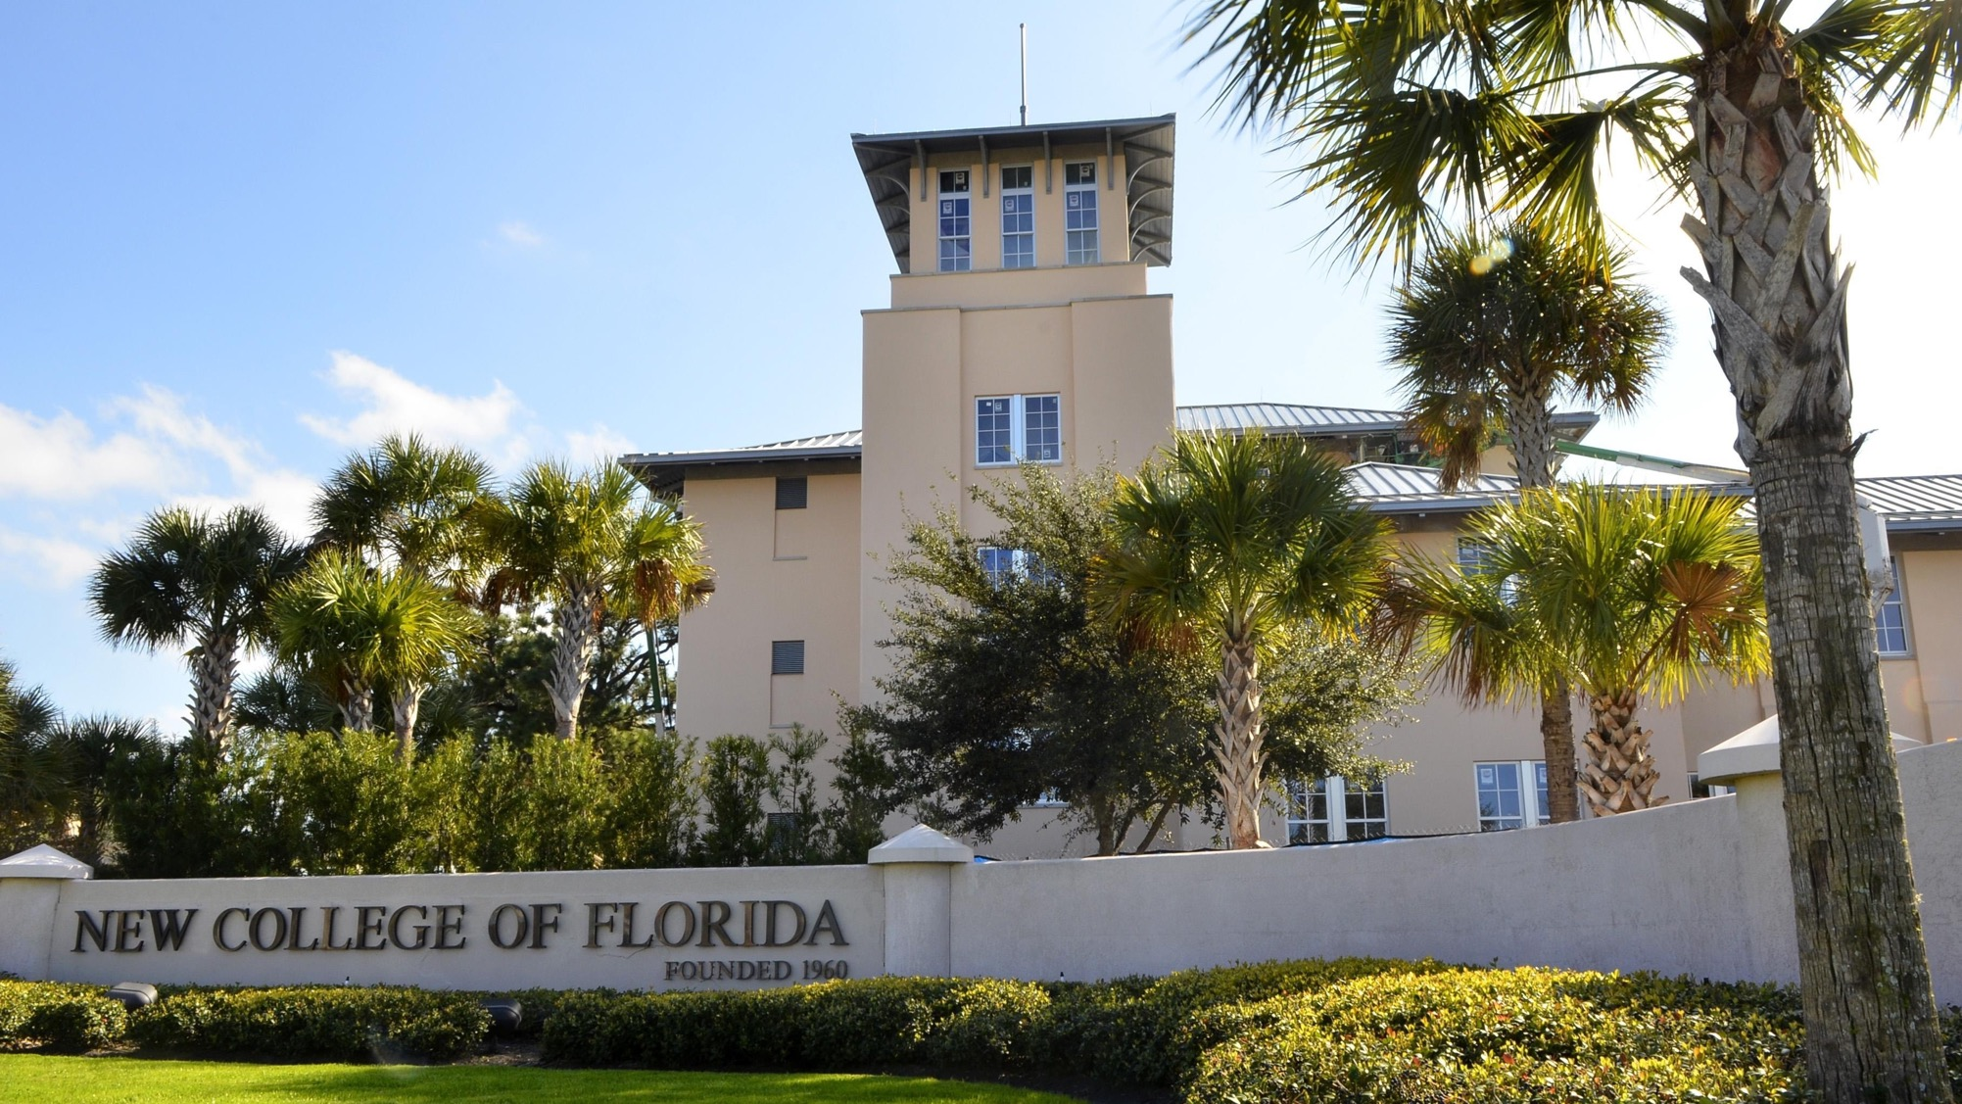
Operating Budget

Slide 2
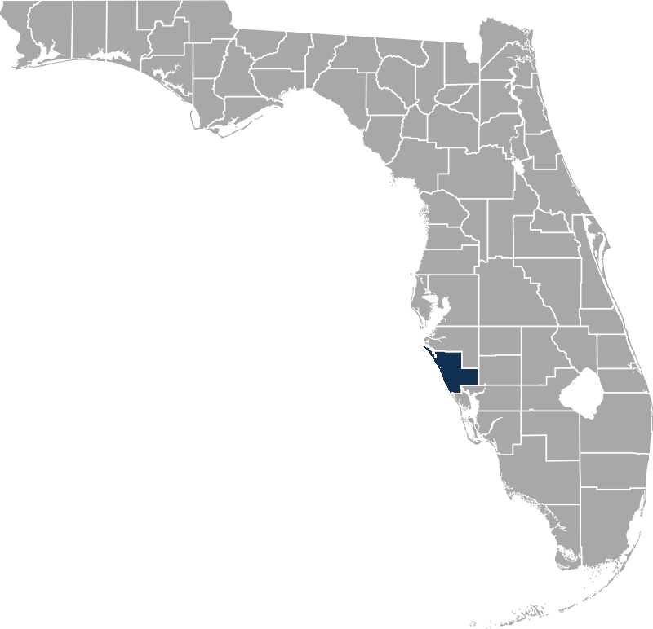
#3 Public Liberal Arts College
- Washington Monthly (2019)
#6 Public Liberal Arts College
- U.S. News & World Report (2019)
Top 10 Best Buy Public College
- Fiske Guide to Colleges (2019)
#23 Best Value in Higher Education
- Kiplinger’s Personal Finance (2019)
#35 Most Innovative School
- U.S. News & World Report (2019)
#47 Best Value Public College
- Forbes (2019)
Top 50 Colleges that Create Futures
- Princeton Review (2019)
*
Top 6
Public Liberal Arts College
15 consecutive years
2

Slide 3
SUS
Education & General Expenditures
2018-19
4

Slide 4
2019-20 Funding sources
E&G (Tuition & Fees)
$4.0 M
Auxiliaries
$6.9 M
7%
Local Funds
$5.6 M
Contracts & Grants
$3.6 M
Education & General
(General Revenue, Lottery)
$37.0 M
65%
5

Slide 5
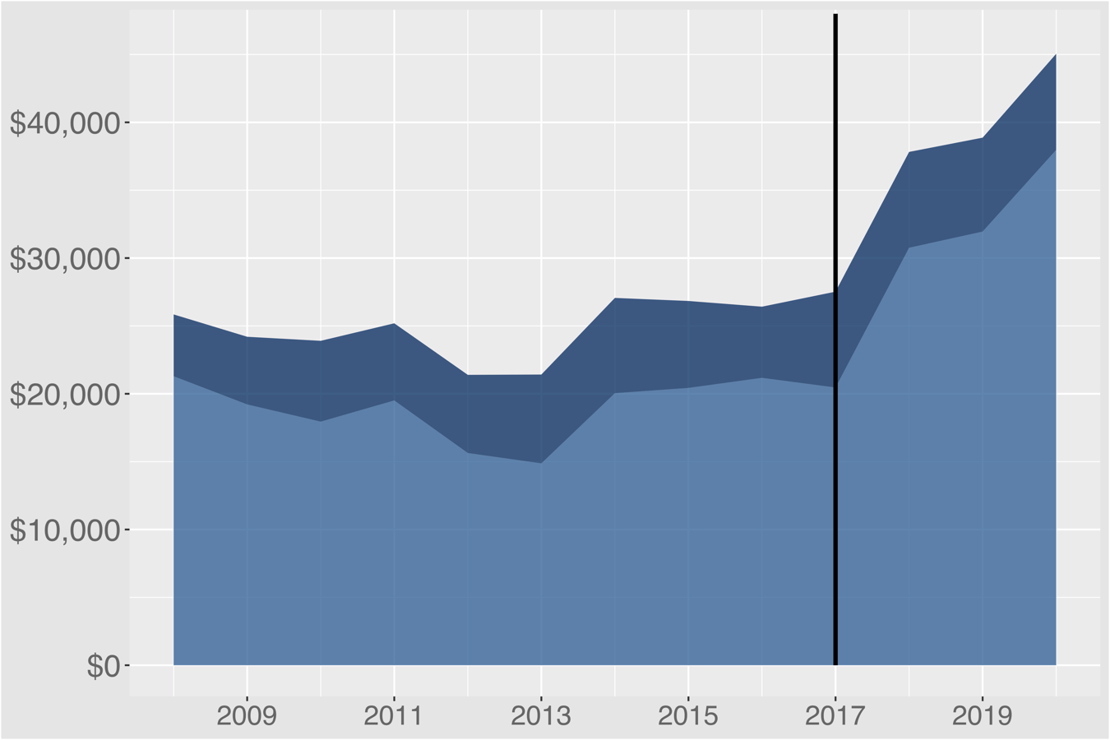
E&G Appropriations per FTE
Growth Funding
Tuition & Fees
– 0.4% per year
+$17,510
per FTE
Other E&G Appropriations
6

Slide 6
E&G Appropriations per FTE
Growth Funding
$37,968 per FTE (2019-20)
Growth
$23,500 per FTE
E&G Appropriations
(less tuition)
7

Slide 7
General Revenue per FTE — Top Public Liberal Arts
 | General Revenue per FTE average from 2008-17 (does not include tuition + fees)
U.S. Air Force Academy | $117,277
U.S. Military Academy | $86,680
U.S. Naval Academy | $84,177
Virginia Military Institute | $22,766
 | $18,636
Source: Most recently available IPEDS data (2016-17)
8

Slide 8
2018-19 E&G Expenditures
Administrative Support
$7.8 M
Physical Plant
$5.9 M
42%
Instruction & Research
$15.2 M
Student Services
$5.7 M
Library
$1.3 M
9

Slide 9
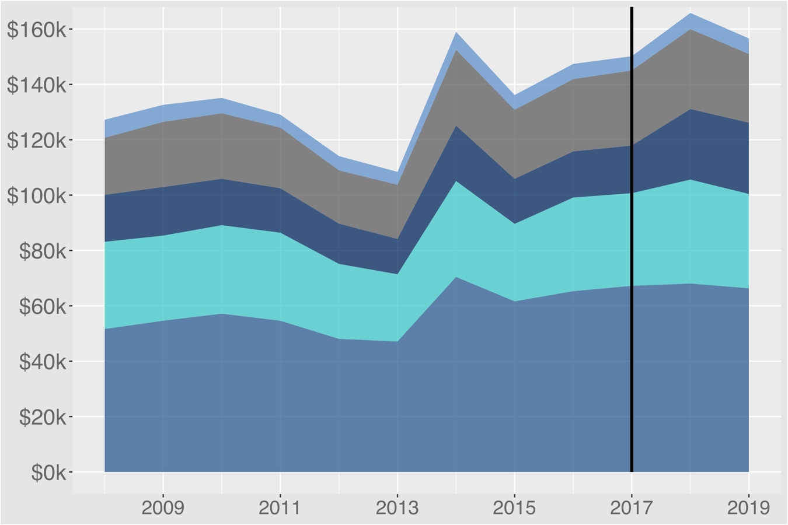
E&G Expenditures per degree
Growth Funding
Library
Student Services
Physical Plant
Administrative Support
Instruction & Research
10

Slide 10
E&G Expenditures per degree
Growth Funding
$156k per degree (18-19)
Growth
$108k per degree
11

Slide 11
Is New College worth it?
12

Slide 12
Expenditures per degree— Top Public Liberal Arts
 | Core expenditures per degree average from 2015-17 | Administrative Support Expenditures per Degree average from 2015-17
Air Force, Military, Naval Academies | $407,568 | $70,924
Top 25 Private Liberal Arts | $259,833 | $52,728
Ranked 26-50 Private Liberal Arts | $206,613 | $45,048
actual at 1200 students | $187,825 $98,535 | $53,694 $28,168
Source: IPEDS expenditures in Instruction, Research, Academic Support, Public Service, Student Support, Institutional Support
13

Slide 13

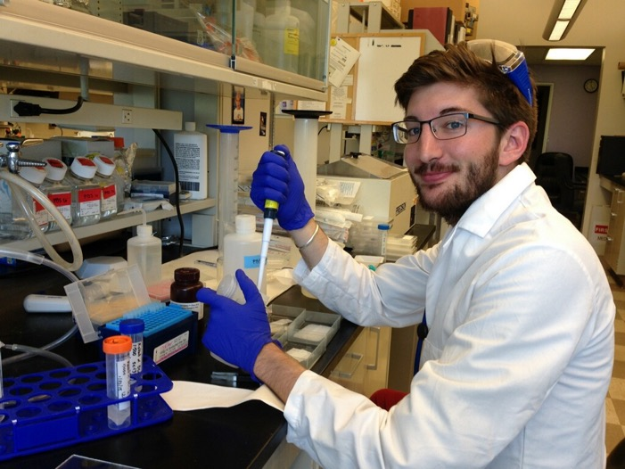

#1 — % earning doctoral degrees
in Science & Engineering
among public universities
- National Science Foundation data (2017)
13% of all Fulbrights in the SUS
since 2001
14

Slide 14
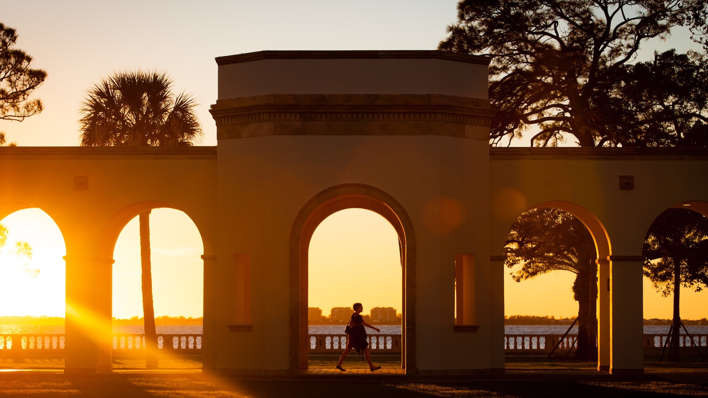


Slide 15
Headcount Enrollment
Fall 2018
SUS
SUS avg > 31k
A

Slide 16
Headcount Enrollment
Top 50 Liberal Arts & Sciences Schools
Compared to SUS average
Fall 2018
Top 50 Liberal Arts
SUS avg > 31k
avg = 2,142
837
B

Slide 17
Top 50 Liberal Arts & Sciences Schools
by Headcount Enrollment
412
1,291
837
C

