Slide 1
Three Act Math
Documentation of implementation
Bradley Lands
Michelle Janney

Slide 2
Three Act Math: Philosophy
"Storytelling gives us a framework for certain mathematical tasks that is both prescriptive enough to be useful and flexible enough to be usable. Many stories divide into three acts, each of which maps neatly onto these mathematical tasks."
-Dan Meyer

Slide 3
Why Three Act Math?
"Many math teachers take act two as their job description. Hit the board, offer students three worked examples and twenty practice problems. However, it's clear to me that the second act isn't our job anymore. Not the biggest part of it, anyway. You are only one of many people your students can access as they look for resources and tools. Going forward, the value you bring to your math classroom increasingly will be tied up in the first and third acts of mathematical storytelling, your ability to motivate the second act and then pay off on that hard work."
-Dan Meyer

Slide 4
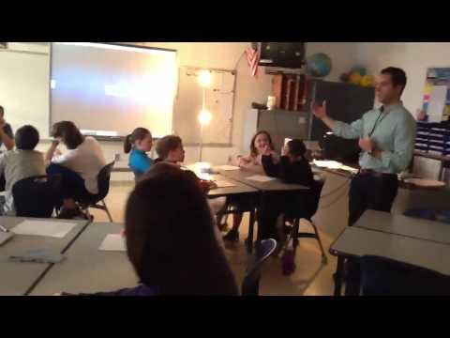
Mathematical Inquiry

Slide 5
Act One
Introduce the central conflict of your story/task clearly, visually, viscerally, using as few words as possible.

Slide 6

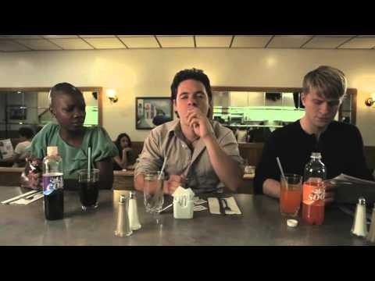
Act I

Slide 7
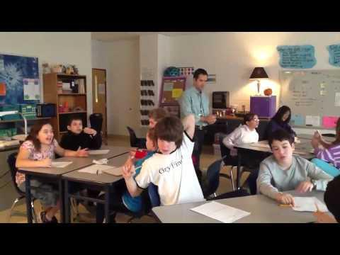
Act I: Follow Up

Slide 8
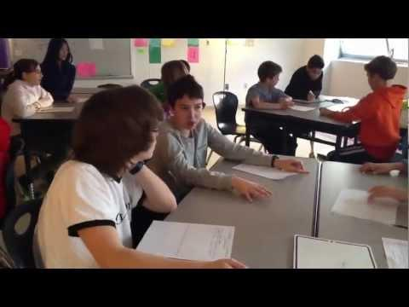
Act I: Formulating Questions

Slide 9
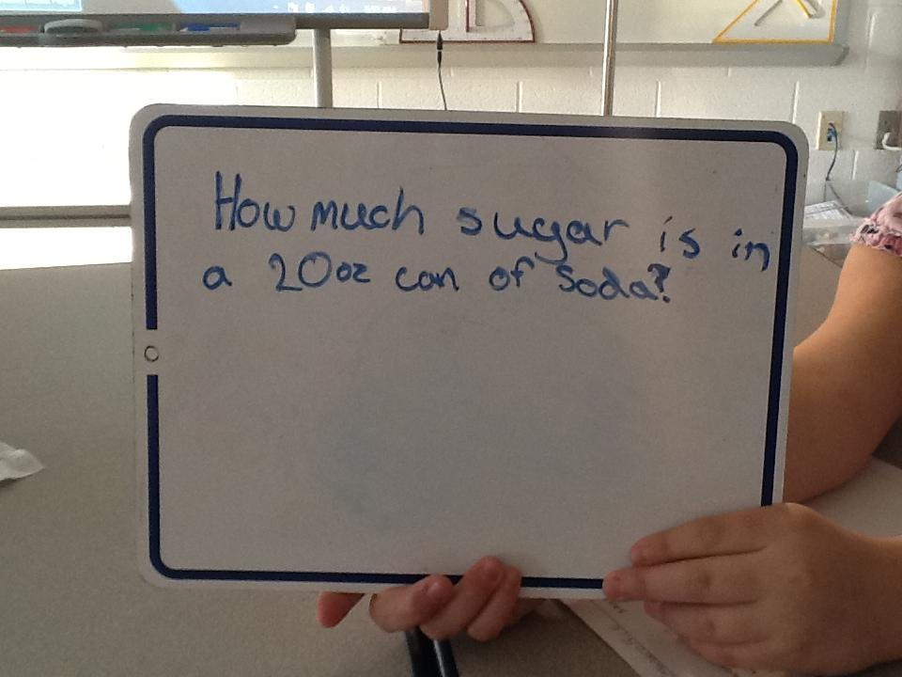
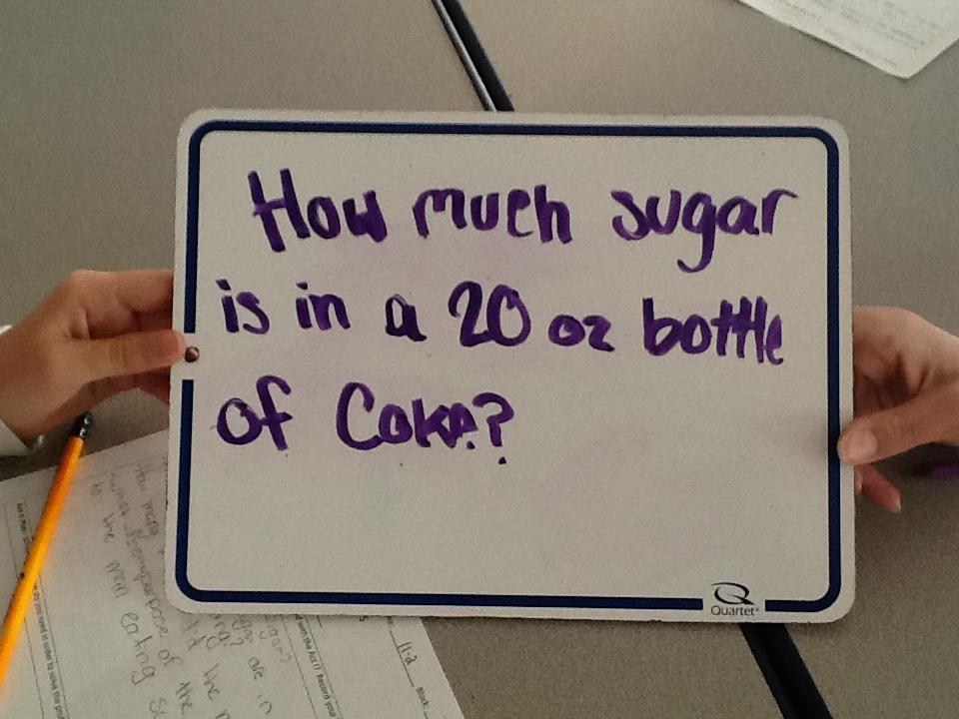
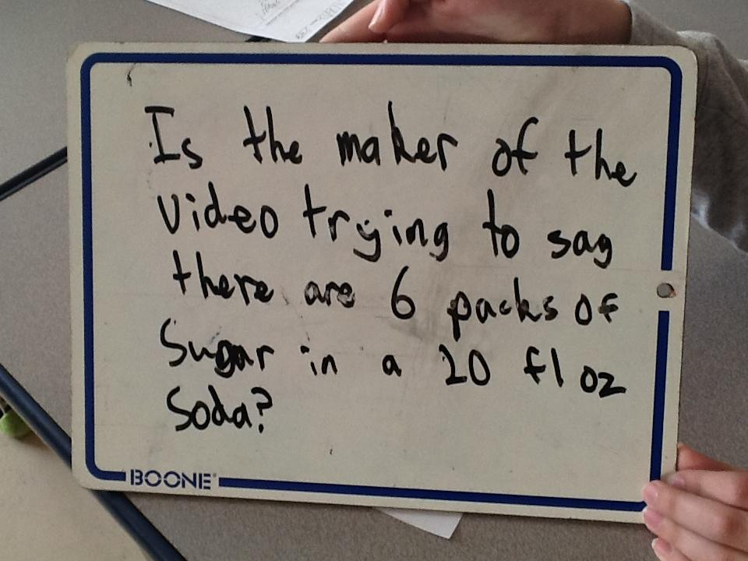
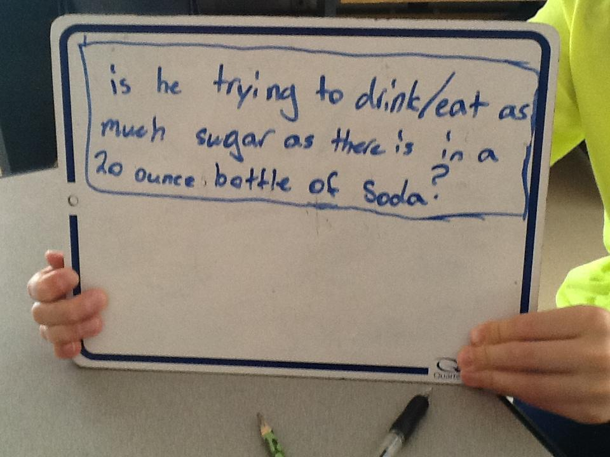
Act I: Group Questions

Slide 10
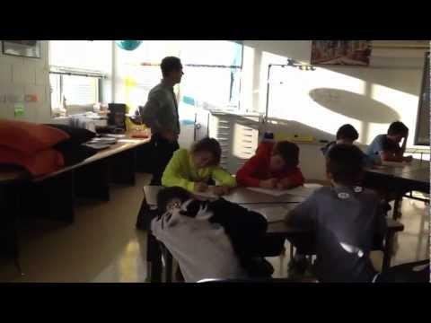
Act I: Driving Question

Slide 11
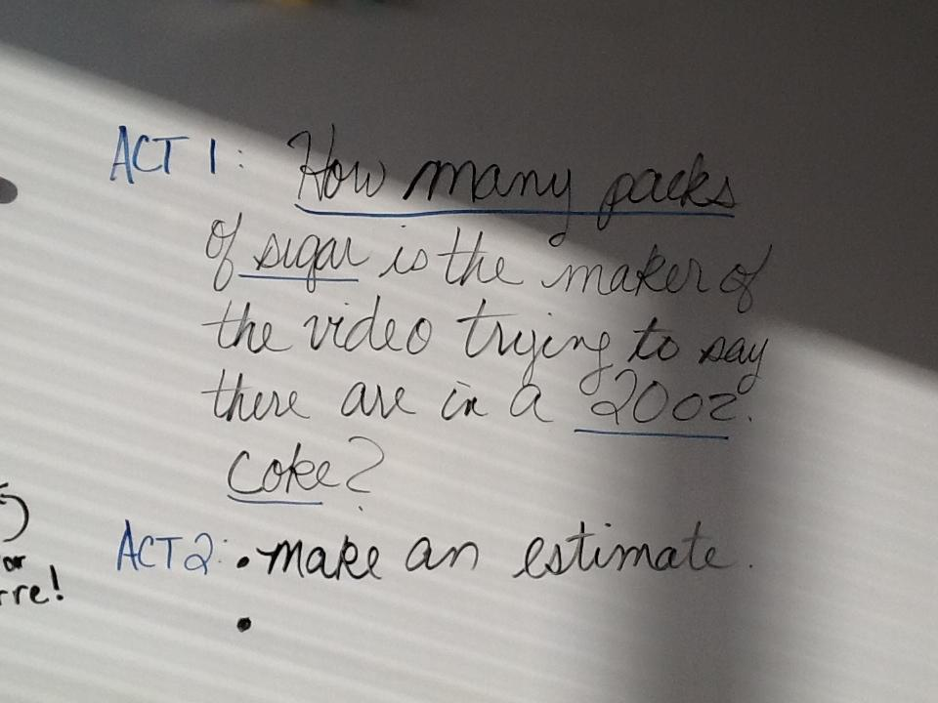
Driving Question

Slide 12
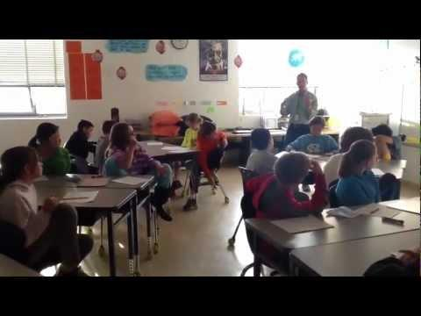
Act I: Estimation Directions

Slide 13
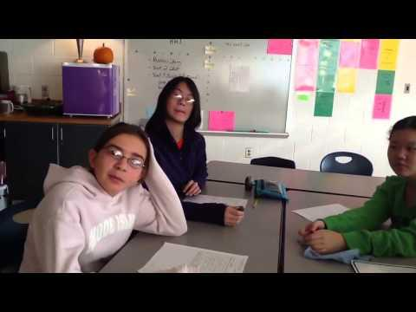
Act I: Estimation

Slide 14
Act Two
The protagonist/student overcomes obstacles, looks for resources, and develops new tools.

Slide 15
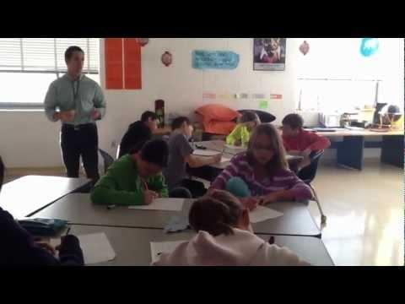
Act II

Slide 16
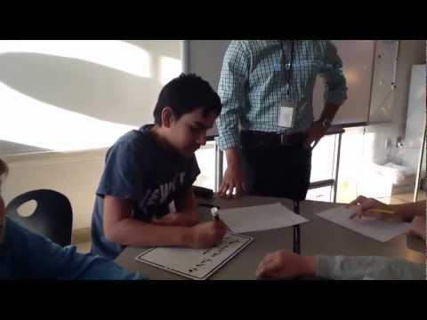
Act II: What information is needed?

Slide 17
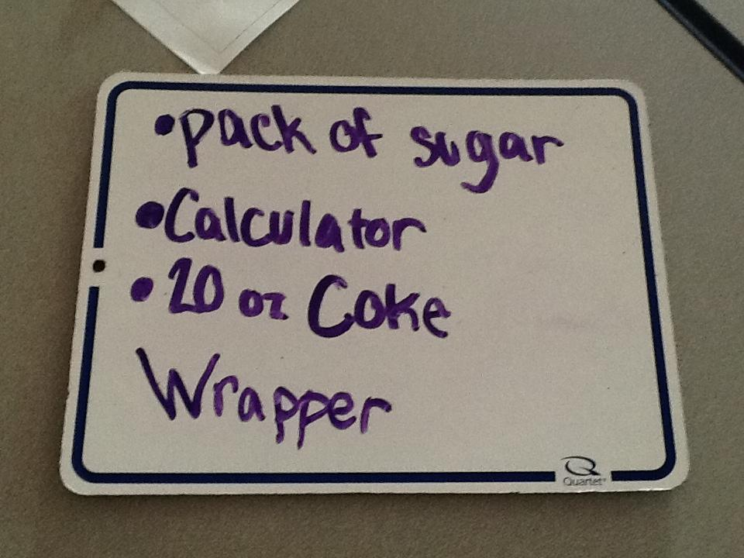
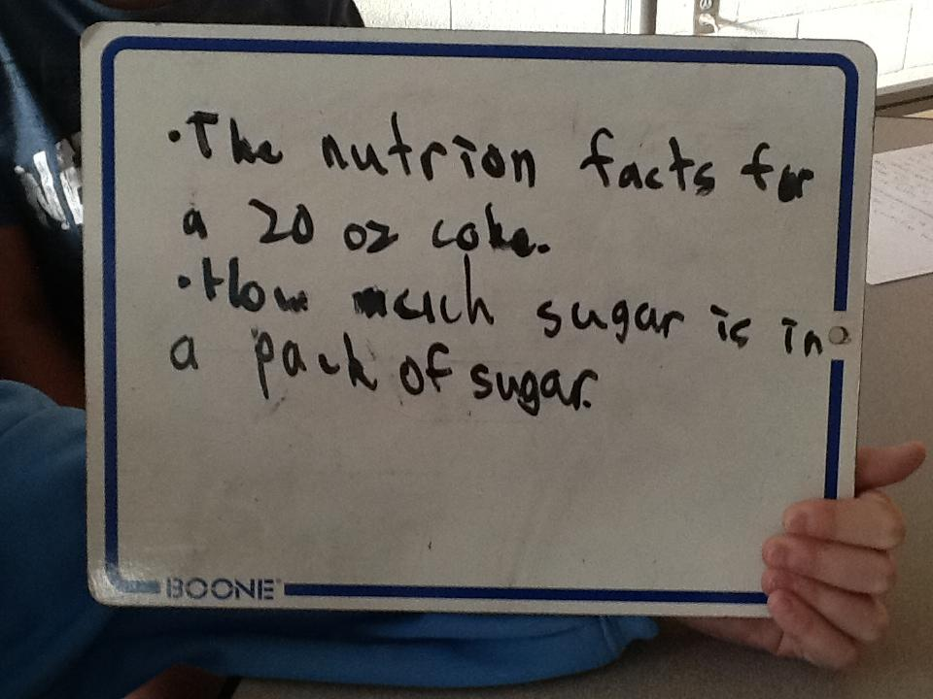
Act II: Information & Resources

Slide 18
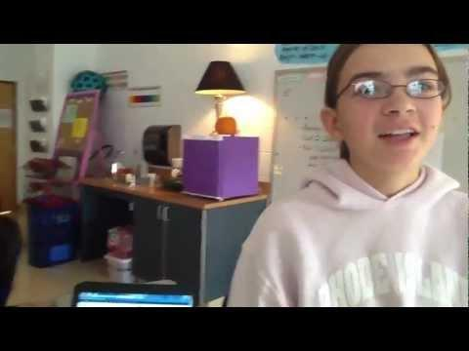
Act II: Performing Research

Slide 19
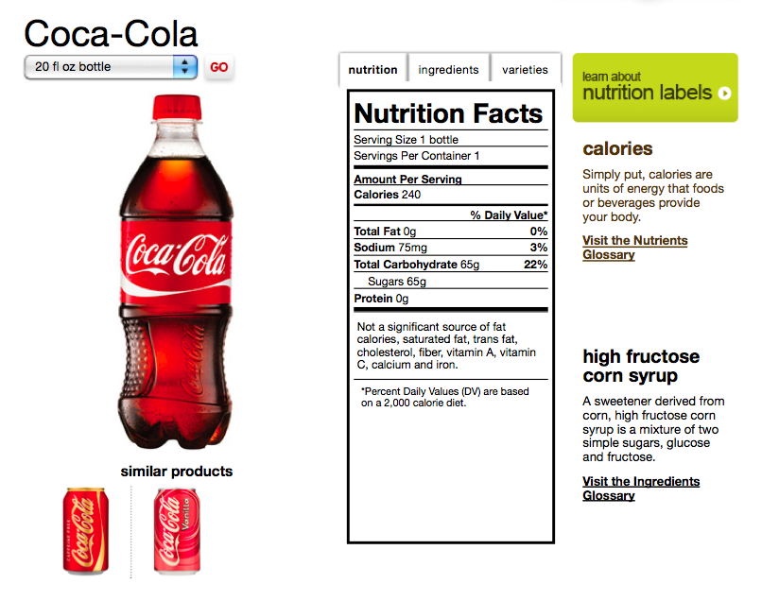
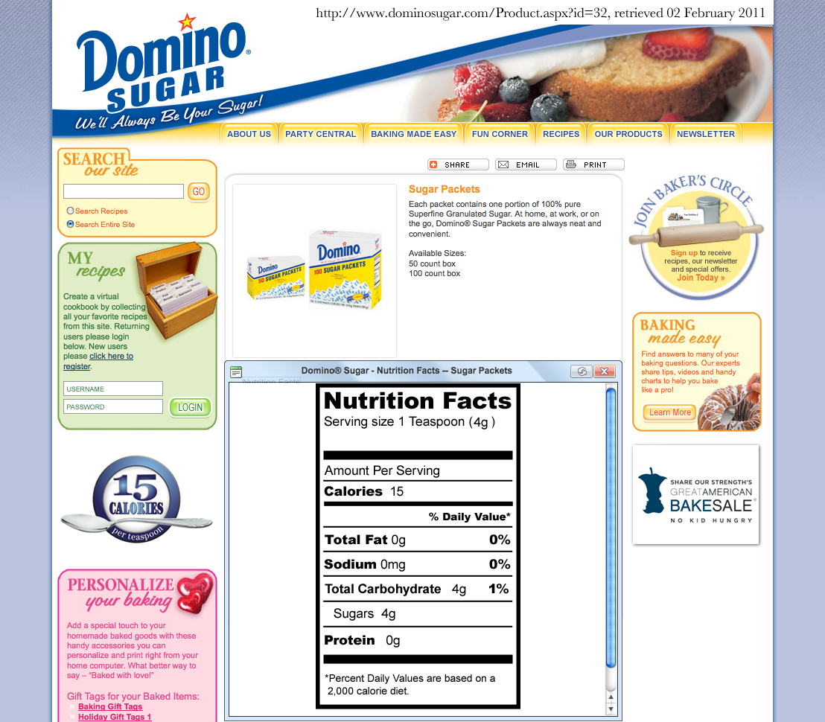
Act II: Information Gathered

Slide 20
Act Three
Resolve the conflict and set up a sequel/extension.
The payoff in the third act needs to meet their expectations

Slide 21
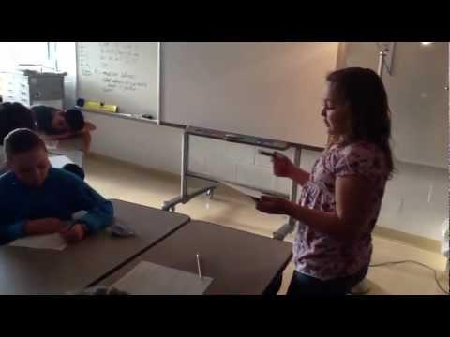
Act III

Slide 22
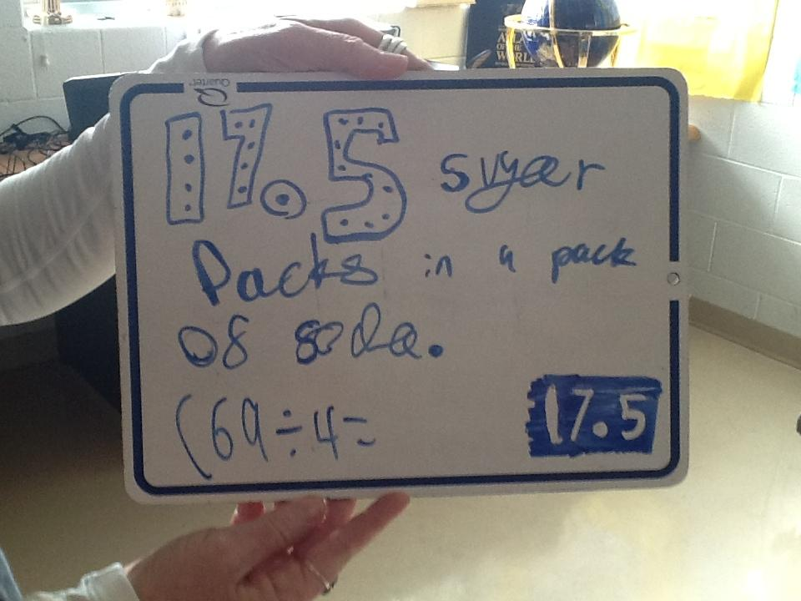
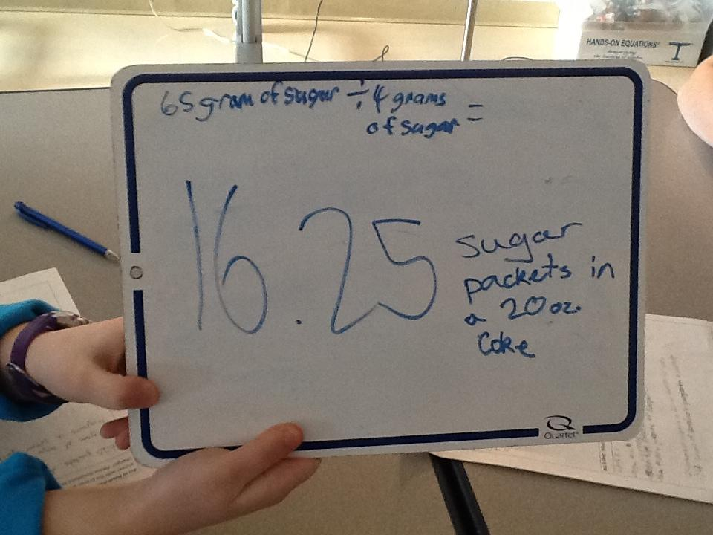
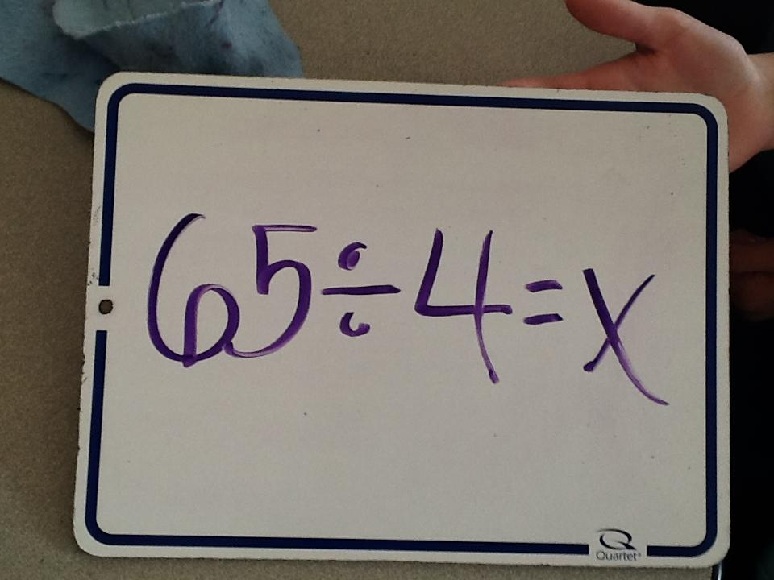
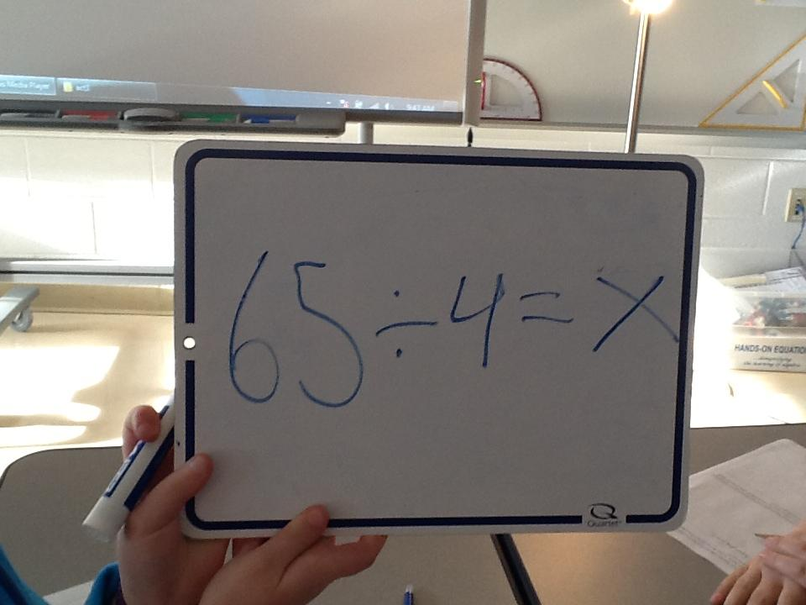
Act III: Documentation of Work

Slide 23
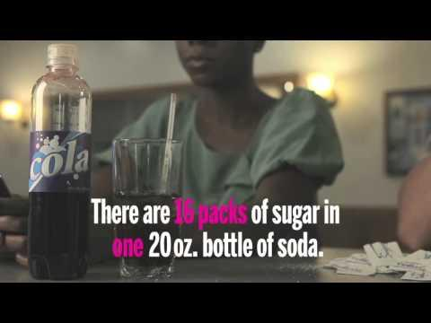
Act III: Proof of Answer

Slide 24
Sequel
Extension problem: New questions asked by students that stems from what they learned.

Slide 25
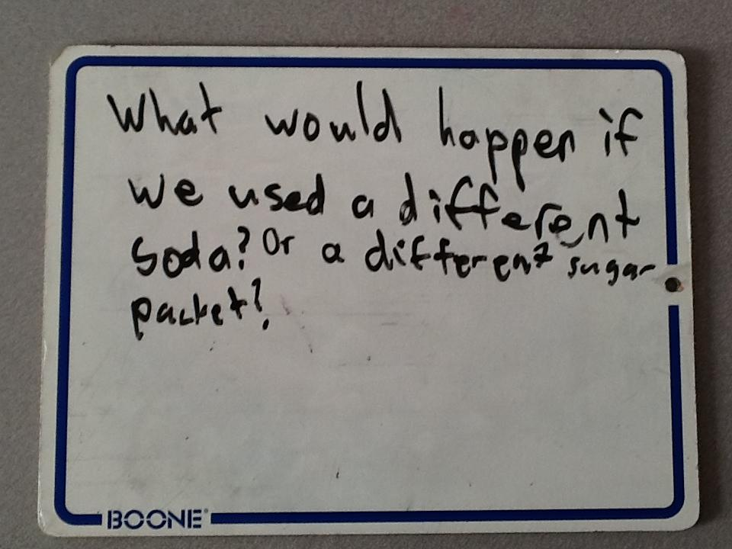
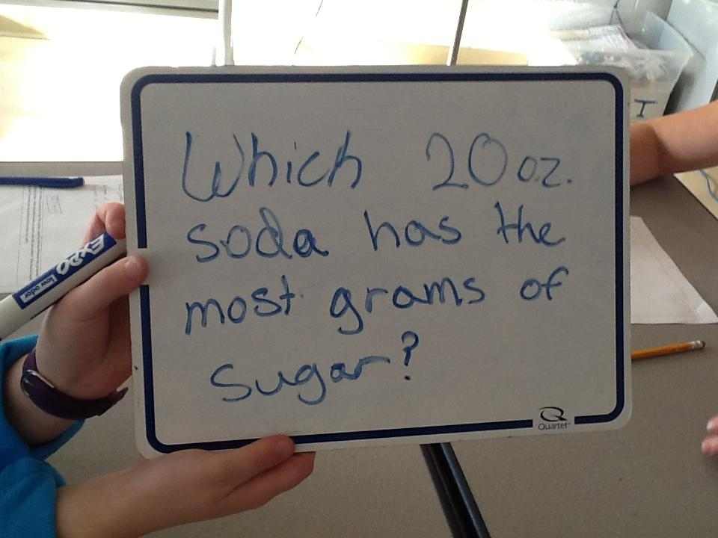
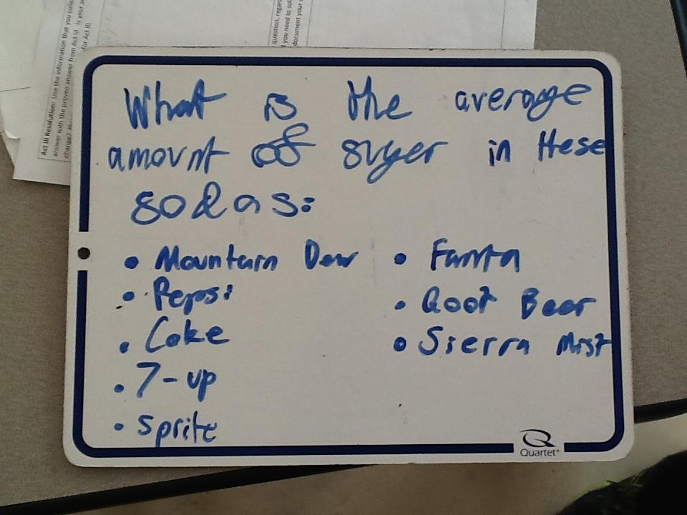
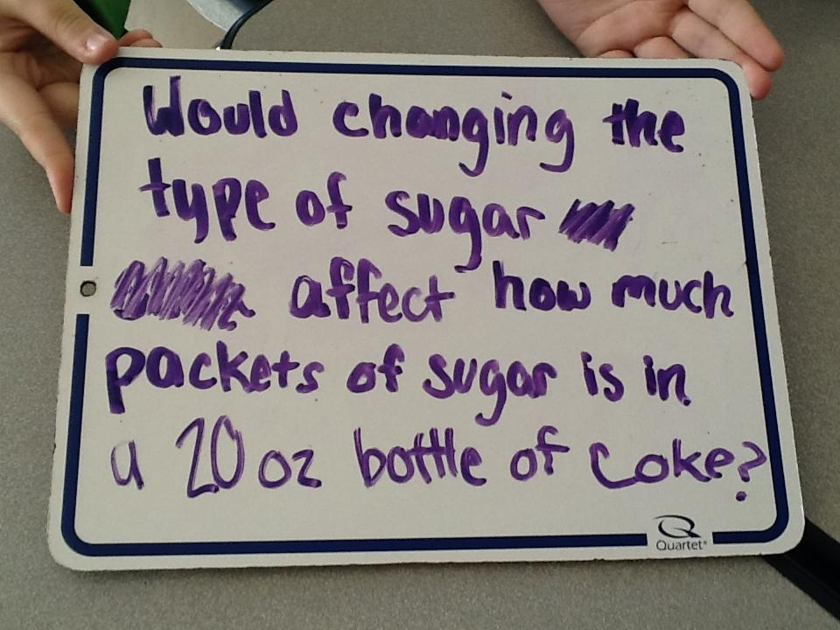
Sequel Questions

Slide 26
References
Dan Meyer
http://blog.mrmeyer.com/
TED Talks: Dan Meyer Math Curriculum Makeover
http://www.ted.com/talks/dan_meyer_math_curriculum_makeover.html
The Three Acts of a Mathematical Story
http://blog.mrmeyer.com/?p=10285
Sugar Packets Lesson Plan:http://threeacts.mrmeyer.com/sugarpackets/
Dan Meyer's Three Act Math Curriculum: http://goo.gl/GpNNt

